Slide 1
Advanced data Security
Part II:
Communication Security
Chapter7: Protocols For Secure
Communications
1

Slide 2
What is network security?
confidentiality: only sender, intended receiver should
“understand” message contents
sender encrypts message
receiver decrypts message
authentication: sender, receiver want to confirm identity of each other
message integrity: sender, receiver want to ensure message
not altered (in transit, or afterwards) without detection
access and availability: services must be accessible and available to users
Security 8-2

Slide 3
Protocols for Secure Communications
Much of the software currently used to protect the confidentiality of information are not true cryptosystems
They are applications to which cryptographic protocols have
been added
Particularly true of Internet protocols
As the number of threats to the Internet grew, so did the need for additional security measures
Principles of Information Security, Fourth Edition
3

Slide 4
Securing Internet Communication with S- HTTP and SSL
Secure Socket Layer (SSL) protocol:
  uses public key encryption to secure channel over public Internet
Secure Hypertext Transfer Protocol (S-HTTP):
  extended version of Hypertext Transfer Protocol; provides for encryption of individual messages between client and server across Internet.
  It is an encrypted solution to the unsecured version of HTTP.
S-HTTP is the application of SSL over HTTP(https-Microsoft)
  Allows encryption of information passing between computers through
protected and secure virtual connection
Principles of Information Security, Fourth Edition
4

Slide 5

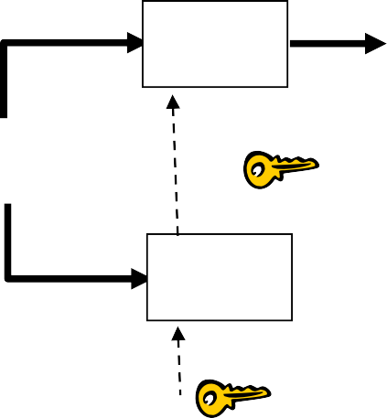





Secure e-mail
Alice wants to send confidential e-mail, m, to Bob.
K_{S}
K_{S}(.)
K_{S}(m ) K_{S}(m )
K_{S}(.)
K_{S}
m
m
+
-
+ .
Internet
- .
K_{S}
K_{B}( )
+
+
K_{B}( )
K_{B}(K_{S} )
K_{B}(K_{S} )
_{K}+
_{K}-
B
B
Alice:
generates random symmetric private key, K_{S}
encrypts message with K_{S} (for efficiency)
also encrypts K_{S} with Bob’s public key
sends both K_{S}(m) and K_{B}(K_{S}) to Bob
Security 8-5

Slide 6
Secure e-mail
Alice wants to send confidential e-mail, m, to Bob.
K_{S}
K_{S}(.)
K_{S}(m ) K_{S}(m )
K_{S}(.)
K
m
m
+
-
Internet
S
+ .
- .
K_{S}
K_{B}( )
+
+
K_{B}( )
K_{B}(K_{S} )
K_{B}(K_{S} )
_{K}+
_{K}-
B
B
Bob:
uses his private key to decrypt and recover K_{S}
uses K_{S} to decrypt K_{S}(m) to recover m
Security 8-6

Slide 7




Secure e-mail (continued)
Alice wants to provide sender authentication message integrity
_{K}-
_{K}+
A
A
.
- .
-
-
+ .
K_{A}(H(m))
K_{A}(H(m))
H(m )
m
H( )
K_{A}( )
K_{A}( )
+
-
compare
Internet
H(.)
m
H(m )
m
Alice digitally signs message
sends both message (in the clear) and digital signature
Security 8-7

Slide 8




Secure e-mail (continued)
Alice wants to provide secrecy, sender authentication, message integrity.
-
K_{A}
- .
-
H(.)
K_{A}(H(m))
m
K_{A}( )
K
S
K_{S}(.)
+
m
+
+ .
Internet
K_{S}
K_{B}( )
+
K_{B}(K_{S} )
_{K}+
B
Alice uses three keys: her private key, Bob’s public key, newly created symmetric key
Security 8-8

Slide 9
Securing e-mail with S/MIME, PEM, and PGP
Secure Multipurpose Internet Mail Extensions (S/MIME):
  builds on Multipurpose Internet Mail Extensions (MIME) encoding format by adding encryption and authentication through digital signatures based on public key cryptosystems.
Privacy Enhanced Mail (PEM):
  proposed as standard to function with public-key cryptosystems;
  uses 3DES symmetric key encryption
Pretty Good Privacy (PGP):
  uses IDEA Cipher for message encoding
  128-bit symmetric key block encryption algorithm with 64-bit blocks for message encoding.
  uses RSA for symmetric key exchange and for digital signatures.
PGP, PEM, and S/MIME work to secure e-mail operations.
Principles of Information Security, Fourth Edition
9

Slide 10
Securing Web transactions with SET, SSL, and S-HTTP
Secure Electronic Transactions (SET):
  developed by MasterCard and VISA in 1997 to provide protection from electronic payment fraud
  Uses DES to encrypt credit card information transfers and
RSA for key exchange.
  Provides security for both Internet-based credit card transactions and credit card swipe systems in retail stores.
SET, SSL, S-HTTP, Secure Shell (SSH-2), and IP Security (IPSec) work to secure Web browsers, especially at electronic commerce sites.
Principles of Information Security, Fourth Edition
10

Slide 11
SSL: Secure Sockets Layer
widely deployed security protocol
  supported by almost all
browsers, web servers
  https
  billions $/year over SSL
variation -TLS: transport layer security, RFC 2246
provides
  confidentiality
  integrity
  authentication
original goals:
  Web e-commerce
transactions
  encryption (especially credit-card numbers)
  Web-server authentication
  optional client authentication
available to all TCP applications
  secure socket interface
Security 8-11

Slide 12
SSL and TCP/IP
Application
TCP
IP
Application
SSL
TCP
IP
normal application
application with SSL
SSL provides application programming interface (API) to applications
C and Java SSL libraries/classes readily available
Security 8-12

Slide 13

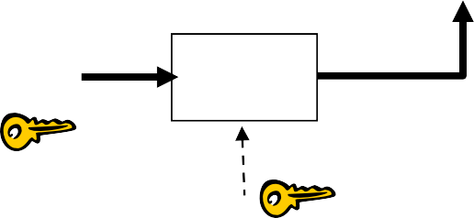
Could do something like PGP:
_{K}-
A
- .
-
H(.)
K_{A}(H(m))
m
K_{A}( )
K_{S}
K_{S}(.)
+
m
+
+ .
Internet
K_{S}
K_{B}( )
+
K_{B}
+
K_{B}(K_{S} )
but want to send byte streams & interactive data
want set of secret keys for entire connection
want certificate exchange as part of protocol: handshake phase
Security 8-13

Slide 14
Toy SSL: a simple secure channel
handshake: Alice and Bob use their certificates, private keys to authenticate each other and exchange shared secret
key derivation: Alice and Bob use shared secret to derive set of keys
data transfer: data to be transferred is broken up into series of records
connection closure: special messages to securely close connection
Security 8-14

Slide 15
Securing Wireless Networks with WEP and WPA
Wired Equivalent Privacy (WEP):
  early attempt to provide security with the 802.11 network protocol
Wi-Fi Protected Access (WPA and WPA2):
  created to resolve issues with WEP
Next Generation Wireless Protocols:
  Robust Secure Networks (RSN), AES – Counter Mode Encapsulation, AES – Offset Codebook Encapsulation
Bluetooth:
  can be exploited by anyone within approximately 30 foot range,
unless suitable security controls are implemented
Principles of Information Security, Fourth Edition

Slide 16
Protocols for Secure Communications
Securing TCP/IP with IPSec
Internet Protocol Security (IPSec):
  open source protocol to secure communications across any IP-based
network
IPSec designed to protect data integrity, user confidentiality, and
authenticity at IP packet level
IPSec combines several different cryptosystems:
  Diffie-Hellman key exchange, Public-key cryptography, Bulk
encryption algorithms, Digital certificates.
In IPSec, IP layer security obtained by use of application header (AH) protocol or encapsulating security payload (ESP) protocol
defines the information to add to an IP packet, as well as how to encrypt
packet data
Principles of Information Security, Fourth Edition

Slide 17
Securing TCP/IP with IPSec and PGP
Internet Protocol Security (IPSec):
  an open-source protocol framework for security development within the TCP/IP family of protocol standards
IPSec uses several different cryptosystems
  Diffie-Hellman key exchange for deriving key material between peers on a public network
  Public key cryptography for signing the Diffie-Hellman
exchanges to guarantees identity
  Bulk encryption algorithms for encrypting the data
  Digital certificates signed by a certificate authority to act as digital ID cards
Principles of Information Security, Fourth Edition

Slide 18
Securing TCP/IP with IPSec and PGP
Pretty Good Privacy (PGP): hybrid cryptosystem designed in 1991 by Phil Zimmermann
  Combined best available cryptographic algorithms to become open source de facto standard for encryption and authentication of e-mail and file storage applications
  Freeware and low-cost commercial PGP versions are available for many platforms
  PGP security solution provides six services: authentication by digital signatures; message encryption; compression; e-mail compatibility; segmentation; key management
Principles of Information Security, Fourth Edition

Slide 19
Table 8-12 PGP Functions²⁴
Principles of Information Security, Fourth Edition

